Slide 1
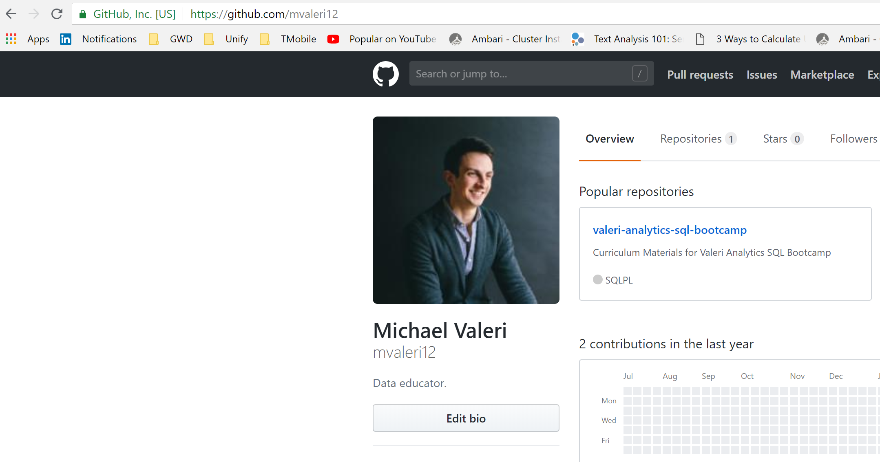
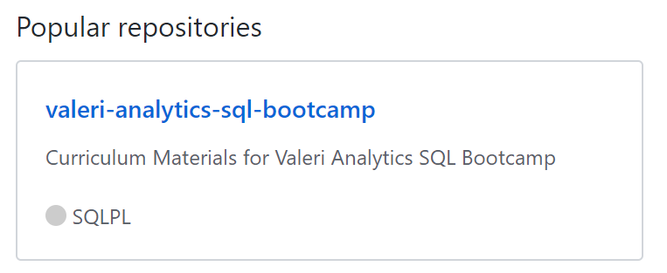
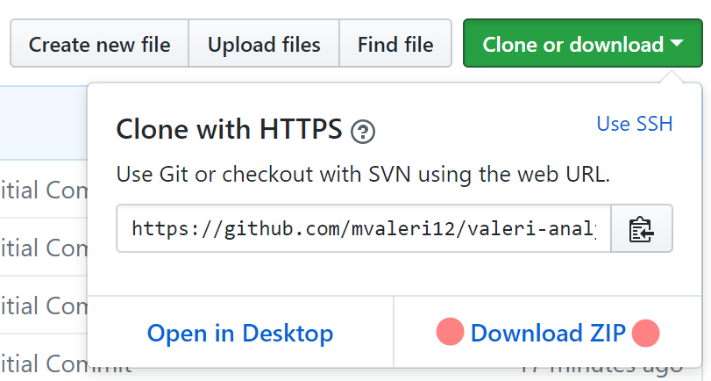
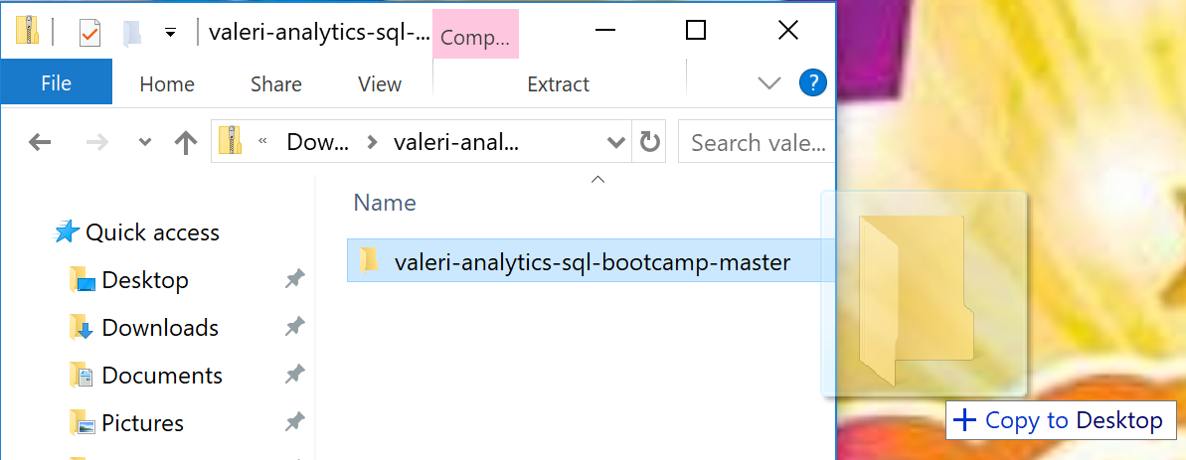
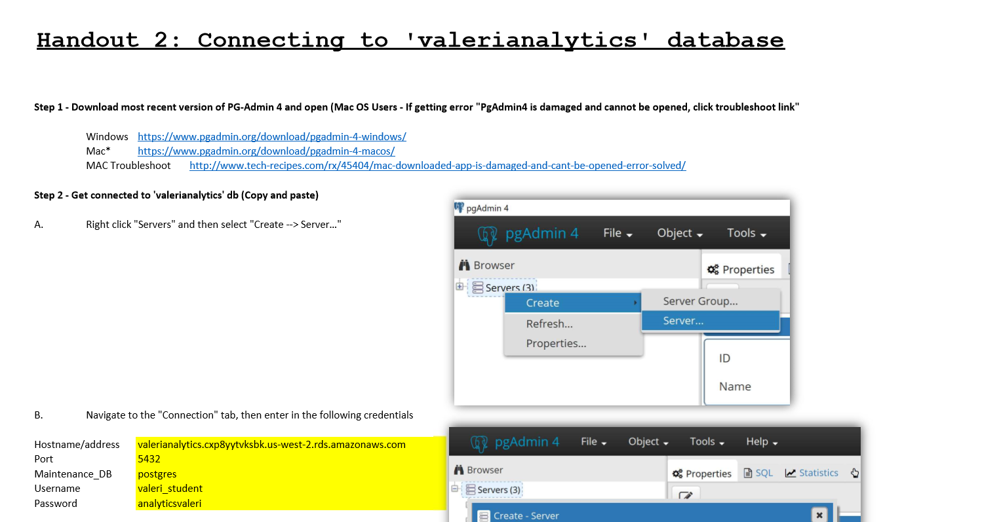
Welcome to Intro to SQL & Databases (Getting Started Guide)
1
2
3
Go to github.com/mvaleri12
Click on ‘valeri-analytics-sql-bootcamp’
Click on ‘Clone or download’ then ‘Download Zip’
4
5
Open zip file in ‘Downloads’ folder, then drag folder onto Desktop
Open ‘00_Valeri_Analytics_Bootcamp’ handout, and follow inst. on ‘Connecting to Valeri Analytics DB’ on Page 3. Install latest version of PG Admin
Notes:
Hello Everyone, and welcome to the 2nd module of Unify's Data and Analytics Certification. In this module we will be covering SQL and Databases.
Before we begin I'd like to introduce myself and give you some background on my experience, "My name is Michael Valeri, a data analytics consultant here at Unify. I've spent the better part of my career mining, refining, and presenting big data to a wide variety of Fortune 500 companies, including Amazon, Expedia, GoDaddy, and T-Mobile.
It's my goal to help people confidently understand data.
In this module we won't explicitly be covering the SYNTAX of SQL, but rather the WHY / WHAT / HOW of SQL.
SQL is shorthand for Structured Query Language...it's a way for us to talk to a database in a question and answer format. The result output is the answer.

Slide 2





*And many more*
Notes:
Before we get started, I’m excited to announce that we’ll have a special guest joining us for today’s lesson. He’s a data guru, and has consulted with the likes of Amazon, GoDaddy, T-Mobile, Expedia, and slew of other Fortune 500 companies. He’s helped answer thousands of business questions that have positively impacted the bottom line.
And today, we’ll get the opportunity to have him answer our business question. Are you folks ready to meet him? Ladies and gentlemen, please welcome to the room, a very good friend of mine, “RED!!”

Slide 3



What is SQL?
Code
Relational Database
Table
Code
GET AN ANSWER
ASK A QUESTION
Products
Related Tables
Stores
ASK A QUESTION
Sales
Related Tables
Notes:
SQL is shorthand for Structured Query Language...it's a way for us to talk to a database in a question and answer format.
A database store's information, in the form of tables. These tables can include customer information, order information, supplier information, or any other information an organization would like to capture.

Slide 4
What is SQL?
Relational Database
Table
Code
ASK A QUESTION
GET AN ANSWER
Related Tables
Sales
Stores
Products
Notes:
SQL is shorthand for Structured Query Language...it's a way for us to talk to a database in a question and answer format.
A database store's information, in the form of tables. These tables can include customer information, order information, supplier information, or any other information an organization would like to capture.

Slide 5
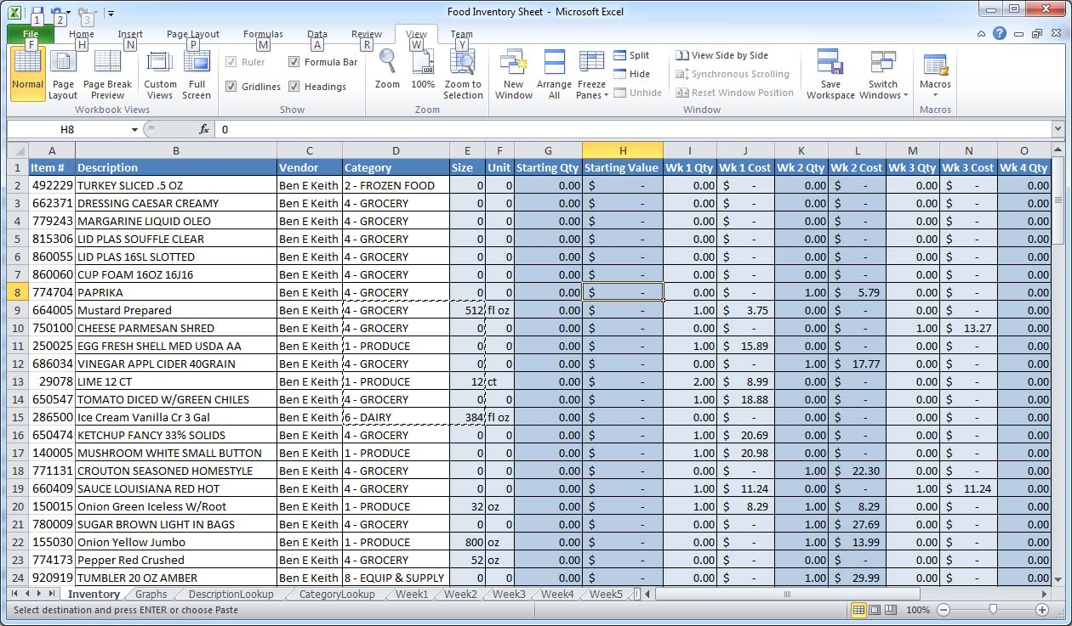



Why do we have to use SQL?
Excel Workbook
ROW Limit = 1 Million
COLLECT BILLIONS AND BILLIONS OF ROWS OF DATA….a day.
Database
ROW Limit = hold my beer
Notes:
So, you might be asking yourself at this point. Ok, I understand what SQL is. It retrieves information from a table. But why can't we just extract the data we need from Excel workbooks? Why does it have to live in this database?
Well, have you ever heard of Amazon.com? They are an e-retailer in the Puget Sound that sells books, DVDs, CDs, and many other items! Estimates say that they generate over a million orders a day!
As a result, amazon couldn't possibly store all this data in an excel file. The row limit is only about 1 MILLLION.
The row limit for a database? IT's virtually unlimited. That’s one of the reasons WE NEED TO USE SQL!

Slide 6



Where does SQL fit in the data flow?
Identify problem
Extract data
Analyze data
Answer problem
Notes:
Ultimately, before we start writing SQL, we are typically trying to answer a problem identified by our client. They might want to know?
1. Why are sales declining in Japan?
2. Why are our customer's choosing iOS over Android devices?
3. Should we be investing more money into MySpace or Friendster?
Once we understand the problem. Then we can start using SQL to extract the information we need from the database to start answering these questions.
Once we have the data extracted from our SQL database, we can typically being analyzing these result-sets in Tableau/Excel or any other analytics tool. We'll be covering some of these tools in module number 3.
Ultimately, we then answer the problems' presented by the client in first step.
The bottleneck in this entire data flow, is centered around Step 2. Extracting the raw data. The truth is, most consultants are really good at identify problems and solving them, but often struggle to extract the data they need to answer the client's question. As a result they typically have to rely on third parties to pull the data for them.
Typically these teams that pull raw data, are resource constrained and data request can take multiple days if not weeks, to be answered.
Consultant's typically have a lot of experience in identifying, problems and using data to

Slide 7



What will I gain from learning SQL?
Tell a client you have a great analytics foundation
Speak to analysts in their own language
You are dangerous with SQL
Eliminate the analytics bottleneck
Notes:
But let's take a step back. Why should I even be watching this video? Why should I even be learning this stuff? Well learning SQL enables you to do a number of things. 1. As a consultant, you'll be able to effectively communicate with other business analysts. You'll be able to speak to them in their own language. You'll also be able to tell a client that you have a great analytics foundation. And ultimately, with your new skills in SQL, you'll be able to eliminate the analytics bottleneck. What is the analytics bottleneck? Well that segues nicely into our next slide, where does SQL fit in the data flow?

Slide 8
Today’s Agenda
INTRODUCTION (10 min) 10:00 – 10:10
Part 1: Database Fundamentals (10 min) 10:10 – 10:20
Part 2: Datatype Fundamentals (10 min) 10:20 – 10:30
Part 3: Connecting to an RDB (15 min) 10:30 – 10:45
Part 4: The Basic Syntax of SQL 11:00 – 11:30
Part 5: Filtering with WHERE 11:30 – 12:00
Part 6: Aggregations and GROUP BY 12:00 – 12:30
LUNCH – (1 HOUR) 12:30 – 01:30
Part 7: Fix the SQL CODE 01:30 – 02:15
Part 8: Joining Tables 02:15 – 03:15
Part 9: Advanced SQL Concepts 03:15 – 03:30
Part 10: Conclusion and Next Steps 03:30 – 03:45
Q:A 03:45 – 04:00
Notes:
But let's take a step back. Why should I even be watching this video? Why should I even be learning this stuff? Well learning SQL enables you to do a number of things. 1. As a consultant, you'll be able to effectively communicate with other business analysts. You'll be able to speak to them in their own language. You'll also be able to tell a client that you have a great analytics foundation. And ultimately, with your new skills in SQL, you'll be able to eliminate the analytics bottleneck. What is the analytics bottleneck? Well that segues nicely into our next slide, where does SQL fit in the data flow?

Slide 9
Part 1 DATABASE FUNDEMENTALS
Notes:
But let's take a step back. Why should I even be watching this video? Why should I even be learning this stuff? Well learning SQL enables you to do a number of things. 1. As a consultant, you'll be able to effectively communicate with other business analysts. You'll be able to speak to them in their own language. You'll also be able to tell a client that you have a great analytics foundation. And ultimately, with your new skills in SQL, you'll be able to eliminate the analytics bottleneck. What is the analytics bottleneck? Well that segues nicely into our next slide, where does SQL fit in the data flow?

Slide 10
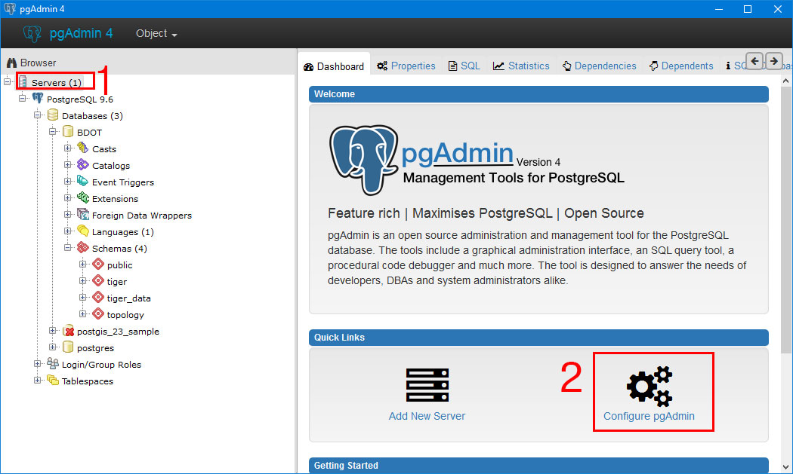

What is a relational database (RDB) and relational database management system (RDBMS)?
Relational Database - PostGreSQL
Relational Database Management System(s) – PGAdmin 4
SQL can…
SELECT data
INSERT data
CREATE data
UPDATE data
DELETE data
Related Tables
Note: Different Dialects of SQL for different Relational Databases
Working with PostGreSQL today
Sales
Stores
Products
Notes:
But let's take a step back. Why should I even be watching this video? Why should I even be learning this stuff? Well learning SQL enables you to do a number of things. 1. As a consultant, you'll be able to effectively communicate with other business analysts. You'll be able to speak to them in their own language. You'll also be able to tell a client that you have a great analytics foundation. And ultimately, with your new skills in SQL, you'll be able to eliminate the analytics bottleneck. What is the analytics bottleneck? Well that segues nicely into our next slide, where does SQL fit in the data flow?

Slide 11








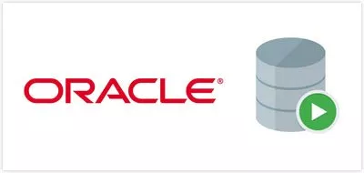
What are the other dialects of SQL databases?
PROS
Free
Scalable and can handle a lot of data
CONS
Spotty Documentation
Configuration can be confusing
PROS
Most Popular for organizations
Robust tools, cutting edge
CONS
Expensive, for small orgs
Significant resource maintenance
PROS
Free
Most popular for web-based apps
Can connect to Oracle
CONS
You need to pay for support
PROS
Fast and stable
Works well MS products
CONS
Expensive
Resource maintenance
Notes:
ORACLE RDBMS → Oracle RDBMS
MYSQl RDBMS →

Slide 12
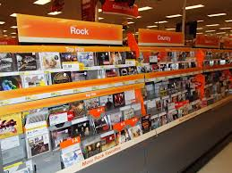




How is data organized in an RDB?
Organized Data
Unorganized Data
Schema
Organized Data in Tables
Notes:
But let's take a step back. Why should I even be watching this video? Why should I even be learning this stuff? Well learning SQL enables you to do a number of things. 1. As a consultant, you'll be able to effectively communicate with other business analysts. You'll be able to speak to them in their own language. You'll also be able to tell a client that you have a great analytics foundation. And ultimately, with your new skills in SQL, you'll be able to eliminate the analytics bottleneck. What is the analytics bottleneck? Well that segues nicely into our next slide, where does SQL fit in the data flow?

Slide 13
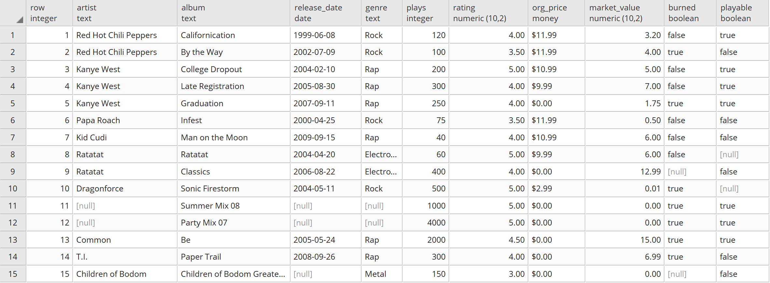
How is data organized in a table in a RDB?
COLUMNS/FIELDS
ROWS/RECORDS
Notes:
But let's take a step back. Why should I even be watching this video? Why should I even be learning this stuff? Well learning SQL enables you to do a number of things. 1. As a consultant, you'll be able to effectively communicate with other business analysts. You'll be able to speak to them in their own language. You'll also be able to tell a client that you have a great analytics foundation. And ultimately, with your new skills in SQL, you'll be able to eliminate the analytics bottleneck. What is the analytics bottleneck? Well that segues nicely into our next slide, where does SQL fit in the data flow?

Slide 14
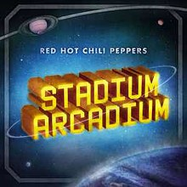



How are the tables related to each other in an RDB?
Notes:
But let's take a step back. Why should I even be watching this video? Why should I even be learning this stuff? Well learning SQL enables you to do a number of things. 1. As a consultant, you'll be able to effectively communicate with other business analysts. You'll be able to speak to them in their own language. You'll also be able to tell a client that you have a great analytics foundation. And ultimately, with your new skills in SQL, you'll be able to eliminate the analytics bottleneck. What is the analytics bottleneck? Well that segues nicely into our next slide, where does SQL fit in the data flow?

Slide 15
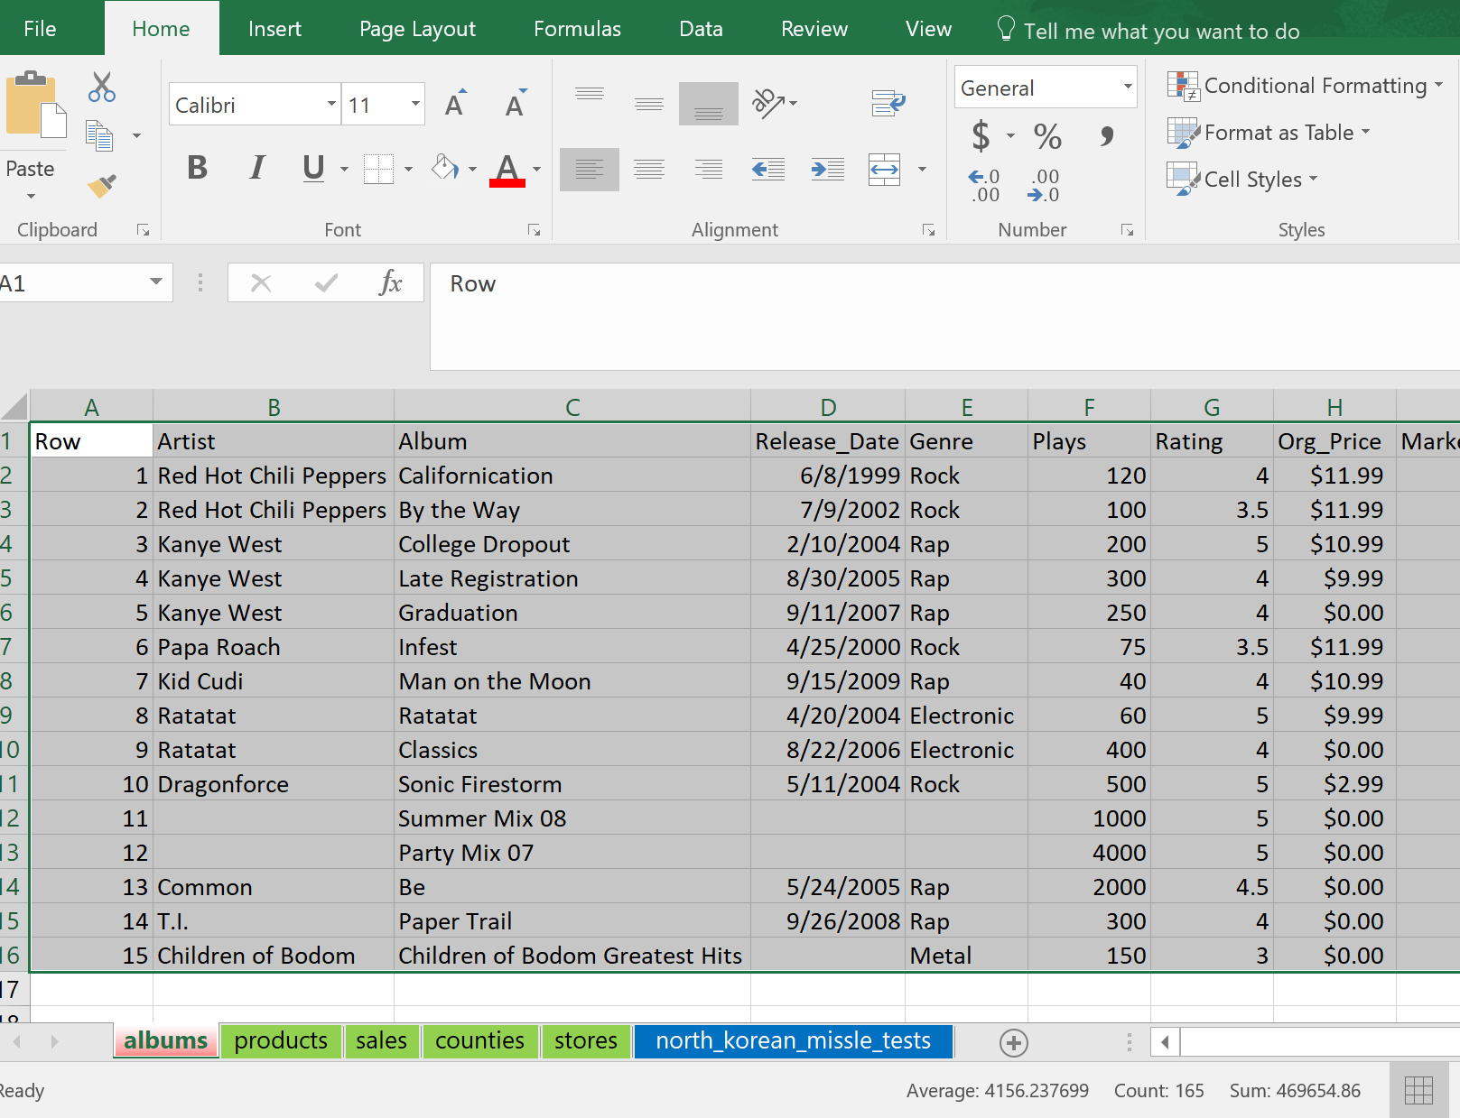
Database vs. Microsoft Excel
Notes:
But let's take a step back. Why should I even be watching this video? Why should I even be learning this stuff? Well learning SQL enables you to do a number of things. 1. As a consultant, you'll be able to effectively communicate with other business analysts. You'll be able to speak to them in their own language. You'll also be able to tell a client that you have a great analytics foundation. And ultimately, with your new skills in SQL, you'll be able to eliminate the analytics bottleneck. What is the analytics bottleneck? Well that segues nicely into our next slide, where does SQL fit in the data flow?

Slide 16
Activity 1: Draw an entity relationship diagram between all the tables
Notes:
But let's take a step back. Why should I even be watching this video? Why should I even be learning this stuff? Well learning SQL enables you to do a number of things. 1. As a consultant, you'll be able to effectively communicate with other business analysts. You'll be able to speak to them in their own language. You'll also be able to tell a client that you have a great analytics foundation. And ultimately, with your new skills in SQL, you'll be able to eliminate the analytics bottleneck. What is the analytics bottleneck? Well that segues nicely into our next slide, where does SQL fit in the data flow?

Slide 17
Activity 1: Draw an entity relationship diagram between all the tables
Notes:
But let's take a step back. Why should I even be watching this video? Why should I even be learning this stuff? Well learning SQL enables you to do a number of things. 1. As a consultant, you'll be able to effectively communicate with other business analysts. You'll be able to speak to them in their own language. You'll also be able to tell a client that you have a great analytics foundation. And ultimately, with your new skills in SQL, you'll be able to eliminate the analytics bottleneck. What is the analytics bottleneck? Well that segues nicely into our next slide, where does SQL fit in the data flow?

Slide 18
Database Fundamentals: Key Takeaways
Not all tables in a database are related to each other
Investigate the column names to see which tables are related to what
Not all column/field names are a 1:1 match
Notes:
But let's take a step back. Why should I even be watching this video? Why should I even be learning this stuff? Well learning SQL enables you to do a number of things. 1. As a consultant, you'll be able to effectively communicate with other business analysts. You'll be able to speak to them in their own language. You'll also be able to tell a client that you have a great analytics foundation. And ultimately, with your new skills in SQL, you'll be able to eliminate the analytics bottleneck. What is the analytics bottleneck? Well that segues nicely into our next slide, where does SQL fit in the data flow?

Slide 19
Part 2 DATATYPE FUNDEMENTALS
Notes:
But let's take a step back. Why should I even be watching this video? Why should I even be learning this stuff? Well learning SQL enables you to do a number of things. 1. As a consultant, you'll be able to effectively communicate with other business analysts. You'll be able to speak to them in their own language. You'll also be able to tell a client that you have a great analytics foundation. And ultimately, with your new skills in SQL, you'll be able to eliminate the analytics bottleneck. What is the analytics bottleneck? Well that segues nicely into our next slide, where does SQL fit in the data flow?

Slide 20
What data types are supported in SQL tables?
BOOLEAN
CHARACTER
NUMERIC
TEMPORAL
DATA TYPE
TRUE / FALSE / (NULL)
Or
1 / 0 / (NULL)
ABC / ABC123 / ABC 123
Or
(NULL)
4 / 5.1
Or
(NULL)
7/4/1776
Or
7/4/1776 23:00:12
Or
23:00:12 OR (NULL)
DATA Example
Field/Column Example
PLAYABLE
ARTIST
RATING
RELEASE DATE
Notes:
But let's take a step back. Why should I even be watching this video? Why should I even be learning this stuff? Well learning SQL enables you to do a number of things. 1. As a consultant, you'll be able to effectively communicate with other business analysts. You'll be able to speak to them in their own language. You'll also be able to tell a client that you have a great analytics foundation. And ultimately, with your new skills in SQL, you'll be able to eliminate the analytics bottleneck. What is the analytics bottleneck? Well that segues nicely into our next slide, where does SQL fit in the data flow?

Slide 21
Activity 2: Guess the data type
BOOLEAN
CHARACTER
NUMERIC
TEMPORAL
A
B
C
D
Notes:
But let's take a step back. Why should I even be watching this video? Why should I even be learning this stuff? Well learning SQL enables you to do a number of things. 1. As a consultant, you'll be able to effectively communicate with other business analysts. You'll be able to speak to them in their own language. You'll also be able to tell a client that you have a great analytics foundation. And ultimately, with your new skills in SQL, you'll be able to eliminate the analytics bottleneck. What is the analytics bottleneck? Well that segues nicely into our next slide, where does SQL fit in the data flow?

Slide 22
Activity 2: Guess the data type
BOOLEAN
CHARACTER
NUMERIC
TEMPORAL
A
B
C
D
FALSE
Notes:
But let's take a step back. Why should I even be watching this video? Why should I even be learning this stuff? Well learning SQL enables you to do a number of things. 1. As a consultant, you'll be able to effectively communicate with other business analysts. You'll be able to speak to them in their own language. You'll also be able to tell a client that you have a great analytics foundation. And ultimately, with your new skills in SQL, you'll be able to eliminate the analytics bottleneck. What is the analytics bottleneck? Well that segues nicely into our next slide, where does SQL fit in the data flow?

Slide 23

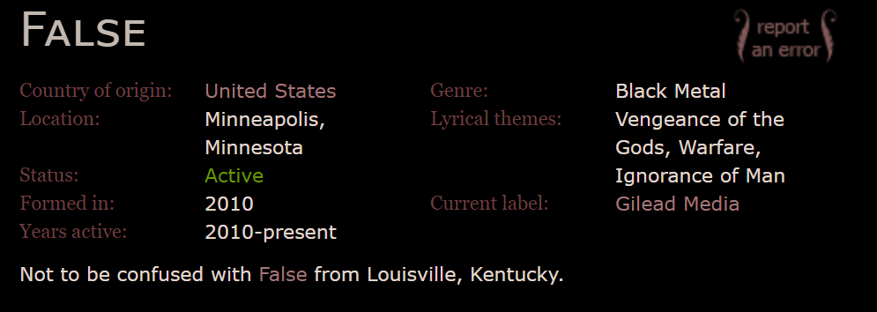
Activity 2: Guess the data type
BOOLEAN
CHARACTER
NUMERIC
TEMPORAL
A
B
C
D
FALSE
Notes:
But let's take a step back. Why should I even be watching this video? Why should I even be learning this stuff? Well learning SQL enables you to do a number of things. 1. As a consultant, you'll be able to effectively communicate with other business analysts. You'll be able to speak to them in their own language. You'll also be able to tell a client that you have a great analytics foundation. And ultimately, with your new skills in SQL, you'll be able to eliminate the analytics bottleneck. What is the analytics bottleneck? Well that segues nicely into our next slide, where does SQL fit in the data flow?

Slide 24
Activity 2: Guess the data type
BOOLEAN
CHARACTER
NUMERIC
TEMPORAL
A
B
C
D
311
Notes:
But let's take a step back. Why should I even be watching this video? Why should I even be learning this stuff? Well learning SQL enables you to do a number of things. 1. As a consultant, you'll be able to effectively communicate with other business analysts. You'll be able to speak to them in their own language. You'll also be able to tell a client that you have a great analytics foundation. And ultimately, with your new skills in SQL, you'll be able to eliminate the analytics bottleneck. What is the analytics bottleneck? Well that segues nicely into our next slide, where does SQL fit in the data flow?

Slide 25

Activity 2: Guess the data type
BOOLEAN
CHARACTER
NUMERIC
TEMPORAL
A
B
C
D
311
Notes:
But let's take a step back. Why should I even be watching this video? Why should I even be learning this stuff? Well learning SQL enables you to do a number of things. 1. As a consultant, you'll be able to effectively communicate with other business analysts. You'll be able to speak to them in their own language. You'll also be able to tell a client that you have a great analytics foundation. And ultimately, with your new skills in SQL, you'll be able to eliminate the analytics bottleneck. What is the analytics bottleneck? Well that segues nicely into our next slide, where does SQL fit in the data flow?

Slide 26
Activity 2: Guess the data type
BOOLEAN
CHARACTER
NUMERIC
TEMPORAL
A
B
C
D
4/29/1992
Notes:
But let's take a step back. Why should I even be watching this video? Why should I even be learning this stuff? Well learning SQL enables you to do a number of things. 1. As a consultant, you'll be able to effectively communicate with other business analysts. You'll be able to speak to them in their own language. You'll also be able to tell a client that you have a great analytics foundation. And ultimately, with your new skills in SQL, you'll be able to eliminate the analytics bottleneck. What is the analytics bottleneck? Well that segues nicely into our next slide, where does SQL fit in the data flow?

Slide 27

Activity 2: Guess the data type
BOOLEAN
CHARACTER
NUMERIC
TEMPORAL
A
B
C
D
4/29/1992
Notes:
But let's take a step back. Why should I even be watching this video? Why should I even be learning this stuff? Well learning SQL enables you to do a number of things. 1. As a consultant, you'll be able to effectively communicate with other business analysts. You'll be able to speak to them in their own language. You'll also be able to tell a client that you have a great analytics foundation. And ultimately, with your new skills in SQL, you'll be able to eliminate the analytics bottleneck. What is the analytics bottleneck? Well that segues nicely into our next slide, where does SQL fit in the data flow?

Slide 28
Datatype Fundamentals: Key Takeaways
Appearances can be deceiving – Find the table schema first, don’t guess data types.
Data type has influence on how we write and format our SQL code.
We can write SQL code to convert datatypes too…
Notes:
But let's take a step back. Why should I even be watching this video? Why should I even be learning this stuff? Well learning SQL enables you to do a number of things. 1. As a consultant, you'll be able to effectively communicate with other business analysts. You'll be able to speak to them in their own language. You'll also be able to tell a client that you have a great analytics foundation. And ultimately, with your new skills in SQL, you'll be able to eliminate the analytics bottleneck. What is the analytics bottleneck? Well that segues nicely into our next slide, where does SQL fit in the data flow?

Slide 29
Part 3 CONNECTING TO AN RDB
Notes:
But let's take a step back. Why should I even be watching this video? Why should I even be learning this stuff? Well learning SQL enables you to do a number of things. 1. As a consultant, you'll be able to effectively communicate with other business analysts. You'll be able to speak to them in their own language. You'll also be able to tell a client that you have a great analytics foundation. And ultimately, with your new skills in SQL, you'll be able to eliminate the analytics bottleneck. What is the analytics bottleneck? Well that segues nicely into our next slide, where does SQL fit in the data flow?

Slide 30

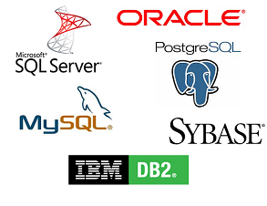

How do you connect to an RDB?
THIS CLASS
YOUR ORGANIZATION
Handout 2: Connecting to 'valerianalytics' database
Notes:
But let's take a step back. Why should I even be watching this video? Why should I even be learning this stuff? Well learning SQL enables you to do a number of things. 1. As a consultant, you'll be able to effectively communicate with other business analysts. You'll be able to speak to them in their own language. You'll also be able to tell a client that you have a great analytics foundation. And ultimately, with your new skills in SQL, you'll be able to eliminate the analytics bottleneck. What is the analytics bottleneck? Well that segues nicely into our next slide, where does SQL fit in the data flow?

Slide 31
Who can help me connect to an RDB at my organization?
Find the Database Administrator (DBA) at your organization. Ask them for credentials
If you can’t find them, find someone who publishes reports. They will probably know.
Remember, you’re probably only looking for SELECT privileges in the RDB.
Don’t GIVE UP, hardest step is just getting access.
YOUR ORGANIZATION
Notes:
But let's take a step back. Why should I even be watching this video? Why should I even be learning this stuff? Well learning SQL enables you to do a number of things. 1. As a consultant, you'll be able to effectively communicate with other business analysts. You'll be able to speak to them in their own language. You'll also be able to tell a client that you have a great analytics foundation. And ultimately, with your new skills in SQL, you'll be able to eliminate the analytics bottleneck. What is the analytics bottleneck? Well that segues nicely into our next slide, where does SQL fit in the data flow?

Slide 32
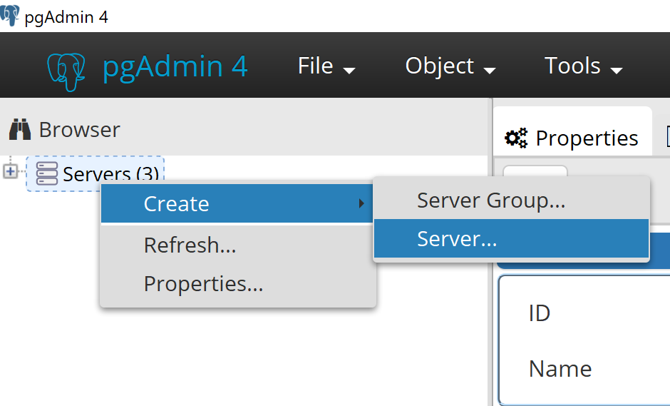
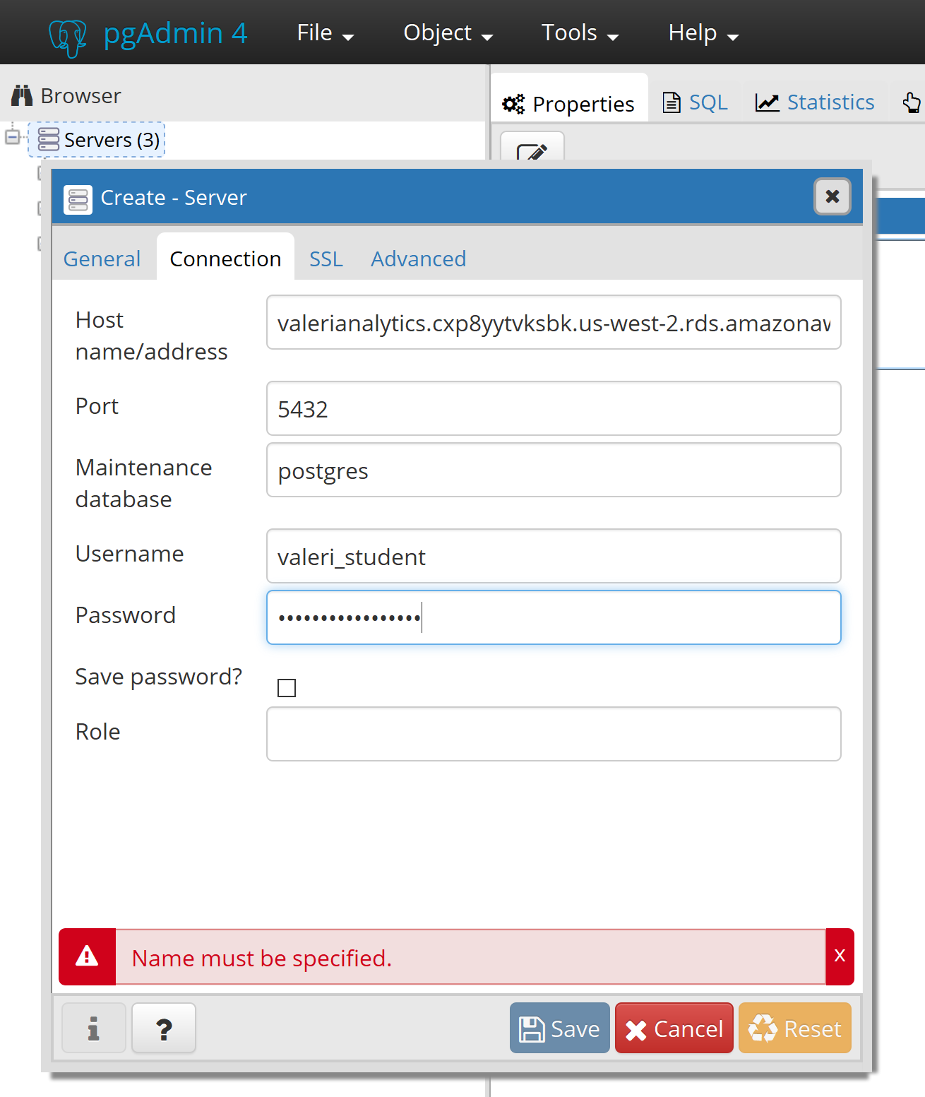
How to connect to valerianalytics RDB
Download PGAdmin 4 (RDBMS)
https://www.pgadmin.org/download/
2. Create a server
3. Input credentials details*
(found in Handout 2: Connecting to ‘valerianalytics’ database)
Notes:
But let's take a step back. Why should I even be watching this video? Why should I even be learning this stuff? Well learning SQL enables you to do a number of things. 1. As a consultant, you'll be able to effectively communicate with other business analysts. You'll be able to speak to them in their own language. You'll also be able to tell a client that you have a great analytics foundation. And ultimately, with your new skills in SQL, you'll be able to eliminate the analytics bottleneck. What is the analytics bottleneck? Well that segues nicely into our next slide, where does SQL fit in the data flow?

Slide 33
Part 4 THE BASIC SYNTAX OF SQL
Notes:
But let's take a step back. Why should I even be watching this video? Why should I even be learning this stuff? Well learning SQL enables you to do a number of things. 1. As a consultant, you'll be able to effectively communicate with other business analysts. You'll be able to speak to them in their own language. You'll also be able to tell a client that you have a great analytics foundation. And ultimately, with your new skills in SQL, you'll be able to eliminate the analytics bottleneck. What is the analytics bottleneck? Well that segues nicely into our next slide, where does SQL fit in the data flow?

Slide 34
What is the basic syntax of SQL?
SELECT
FROM
WHERE
GROUP BY
HAVING
ORDER BY
LIMIT
Fields/columns you’d like to see in result-set
Table(s) where the fields/columns are located
Rows/records you’d like to include/exclude in result-set
Fields/columns you want your aggregate dimensions grouped by
Include/exclude rows/records where aggregate values meet a condition
Sort the rows/records of result-set by ASC/DESC for a column(s)
Limit the number of rows/records to include in result-set.
Notes:
But let's take a step back. Why should I even be watching this video? Why should I even be learning this stuff? Well learning SQL enables you to do a number of things. 1. As a consultant, you'll be able to effectively communicate with other business analysts. You'll be able to speak to them in their own language. You'll also be able to tell a client that you have a great analytics foundation. And ultimately, with your new skills in SQL, you'll be able to eliminate the analytics bottleneck. What is the analytics bottleneck? Well that segues nicely into our next slide, where does SQL fit in the data flow?

Slide 35

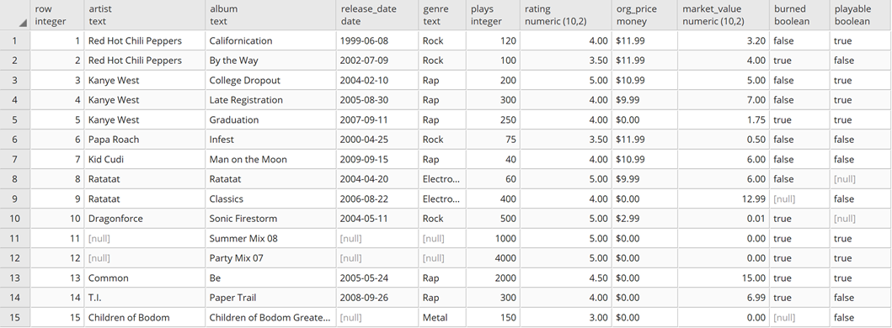


Guided Workshop: Basic SQL Syntax
ASK A QUESTION
GET AN ANSWER
Notes:
But let's take a step back. Why should I even be watching this video? Why should I even be learning this stuff? Well learning SQL enables you to do a number of things. 1. As a consultant, you'll be able to effectively communicate with other business analysts. You'll be able to speak to them in their own language. You'll also be able to tell a client that you have a great analytics foundation. And ultimately, with your new skills in SQL, you'll be able to eliminate the analytics bottleneck. What is the analytics bottleneck? Well that segues nicely into our next slide, where does SQL fit in the data flow?

Slide 36
Independent Workshop : Basic SQL Syntax
ASK A QUESTION
GET AN ANSWER
Notes:
But let's take a step back. Why should I even be watching this video? Why should I even be learning this stuff? Well learning SQL enables you to do a number of things. 1. As a consultant, you'll be able to effectively communicate with other business analysts. You'll be able to speak to them in their own language. You'll also be able to tell a client that you have a great analytics foundation. And ultimately, with your new skills in SQL, you'll be able to eliminate the analytics bottleneck. What is the analytics bottleneck? Well that segues nicely into our next slide, where does SQL fit in the data flow?

Slide 37
BASIC SQL Syntax: Key Takeaways
Any line, any case; SQL can be written on multiple lines or single line in any case for keywords.
Comma chameleon; Whatch out for extra or missing commas in SELECT statement. Most common error in SQL
If you’re having trouble combining multiple/columns fields, you might have to use CAST() to convert data types.
Notes:
But let's take a step back. Why should I even be watching this video? Why should I even be learning this stuff? Well learning SQL enables you to do a number of things. 1. As a consultant, you'll be able to effectively communicate with other business analysts. You'll be able to speak to them in their own language. You'll also be able to tell a client that you have a great analytics foundation. And ultimately, with your new skills in SQL, you'll be able to eliminate the analytics bottleneck. What is the analytics bottleneck? Well that segues nicely into our next slide, where does SQL fit in the data flow?

Slide 38
Part 5 FILTERING WITH WHERE
Notes:
But let's take a step back. Why should I even be watching this video? Why should I even be learning this stuff? Well learning SQL enables you to do a number of things. 1. As a consultant, you'll be able to effectively communicate with other business analysts. You'll be able to speak to them in their own language. You'll also be able to tell a client that you have a great analytics foundation. And ultimately, with your new skills in SQL, you'll be able to eliminate the analytics bottleneck. What is the analytics bottleneck? Well that segues nicely into our next slide, where does SQL fit in the data flow?

Slide 39
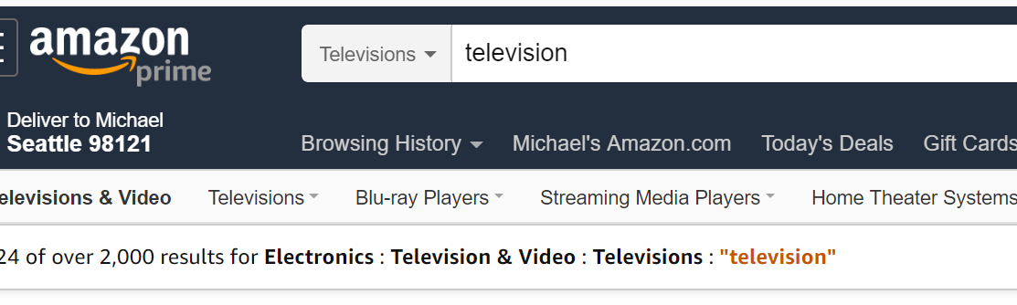
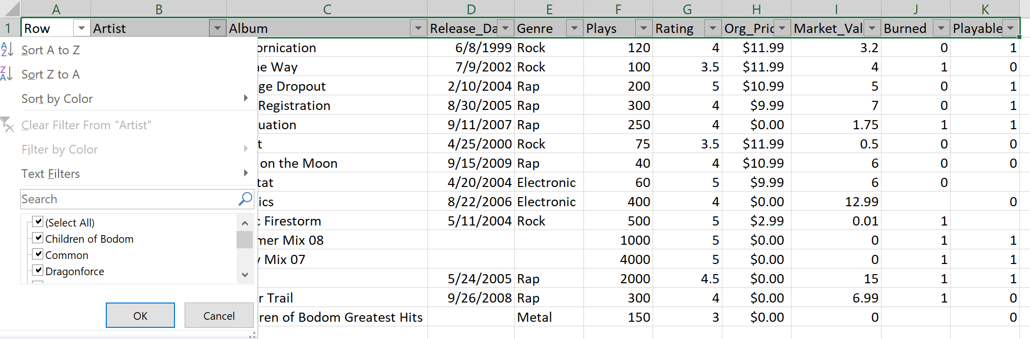
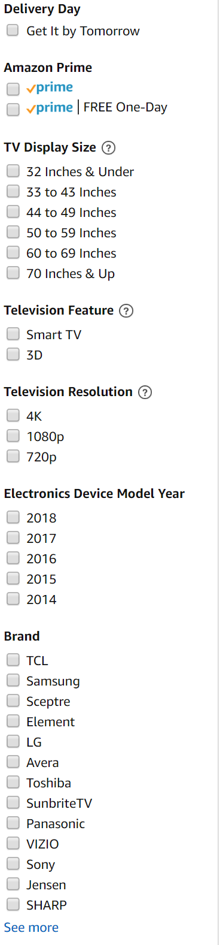



Filtering with WHERE: Comparisons
Notes:
But let's take a step back. Why should I even be watching this video? Why should I even be learning this stuff? Well learning SQL enables you to do a number of things. 1. As a consultant, you'll be able to effectively communicate with other business analysts. You'll be able to speak to them in their own language. You'll also be able to tell a client that you have a great analytics foundation. And ultimately, with your new skills in SQL, you'll be able to eliminate the analytics bottleneck. What is the analytics bottleneck? Well that segues nicely into our next slide, where does SQL fit in the data flow?

Slide 40
Independent Workshop: Filtering with WHERE
ASK A QUESTION
GET AN ANSWER
Notes:
But let's take a step back. Why should I even be watching this video? Why should I even be learning this stuff? Well learning SQL enables you to do a number of things. 1. As a consultant, you'll be able to effectively communicate with other business analysts. You'll be able to speak to them in their own language. You'll also be able to tell a client that you have a great analytics foundation. And ultimately, with your new skills in SQL, you'll be able to eliminate the analytics bottleneck. What is the analytics bottleneck? Well that segues nicely into our next slide, where does SQL fit in the data flow?

Slide 41
Filtering with WHERE: Key Takeaways
Many nuances; Syntax for filtering depends on the column data type you are working with.
You don’t need to SELECT columns you are filtering on in the WHERE clause
Use TO_CHAR() function to simplify dates when filtering. Use LIKE with ‘%’ to look for patterns.
Notes:
But let's take a step back. Why should I even be watching this video? Why should I even be learning this stuff? Well learning SQL enables you to do a number of things. 1. As a consultant, you'll be able to effectively communicate with other business analysts. You'll be able to speak to them in their own language. You'll also be able to tell a client that you have a great analytics foundation. And ultimately, with your new skills in SQL, you'll be able to eliminate the analytics bottleneck. What is the analytics bottleneck? Well that segues nicely into our next slide, where does SQL fit in the data flow?

Slide 42
Part 6 AGGREGATIONS AND GROUP BY
Notes:
But let's take a step back. Why should I even be watching this video? Why should I even be learning this stuff? Well learning SQL enables you to do a number of things. 1. As a consultant, you'll be able to effectively communicate with other business analysts. You'll be able to speak to them in their own language. You'll also be able to tell a client that you have a great analytics foundation. And ultimately, with your new skills in SQL, you'll be able to eliminate the analytics bottleneck. What is the analytics bottleneck? Well that segues nicely into our next slide, where does SQL fit in the data flow?

Slide 43
Guided Workshop: Aggregations and GROUP BY
ASK A QUESTION
GET AN ANSWER
Notes:
But let's take a step back. Why should I even be watching this video? Why should I even be learning this stuff? Well learning SQL enables you to do a number of things. 1. As a consultant, you'll be able to effectively communicate with other business analysts. You'll be able to speak to them in their own language. You'll also be able to tell a client that you have a great analytics foundation. And ultimately, with your new skills in SQL, you'll be able to eliminate the analytics bottleneck. What is the analytics bottleneck? Well that segues nicely into our next slide, where does SQL fit in the data flow?

Slide 44
Independent Workshop: Aggregations and GROUP BY
ASK A QUESTION
GET AN ANSWER
Notes:
But let's take a step back. Why should I even be watching this video? Why should I even be learning this stuff? Well learning SQL enables you to do a number of things. 1. As a consultant, you'll be able to effectively communicate with other business analysts. You'll be able to speak to them in their own language. You'll also be able to tell a client that you have a great analytics foundation. And ultimately, with your new skills in SQL, you'll be able to eliminate the analytics bottleneck. What is the analytics bottleneck? Well that segues nicely into our next slide, where does SQL fit in the data flow?

Slide 45
Aggregations and GROUP BY: Key Takeaways
Use GROUP BY when you want to understand aggregates (SUM/ COUNT/ etc.) by specific fields/columns. I.e. Total sales by Country/Channel.
Aggregate functions and aliases, DO NOT go in the GROUP BY.
You CAN NOT filter on aggregate functions in the WHERE clause, can only filter in HAVING clause.
You CAN NOT perform on aggregate on an aggregate (i.e. Avg(Sum(Plays)) by Genre, need to perform in two steps (more on this later).
Notes:
But let's take a step back. Why should I even be watching this video? Why should I even be learning this stuff? Well learning SQL enables you to do a number of things. 1. As a consultant, you'll be able to effectively communicate with other business analysts. You'll be able to speak to them in their own language. You'll also be able to tell a client that you have a great analytics foundation. And ultimately, with your new skills in SQL, you'll be able to eliminate the analytics bottleneck. What is the analytics bottleneck? Well that segues nicely into our next slide, where does SQL fit in the data flow?

Slide 46
LUNCH (1 Hour) Return at 1:30 PM
Notes:
But let's take a step back. Why should I even be watching this video? Why should I even be learning this stuff? Well learning SQL enables you to do a number of things. 1. As a consultant, you'll be able to effectively communicate with other business analysts. You'll be able to speak to them in their own language. You'll also be able to tell a client that you have a great analytics foundation. And ultimately, with your new skills in SQL, you'll be able to eliminate the analytics bottleneck. What is the analytics bottleneck? Well that segues nicely into our next slide, where does SQL fit in the data flow?

Slide 47
Part 7 FIX THE CODE
Notes:
But let's take a step back. Why should I even be watching this video? Why should I even be learning this stuff? Well learning SQL enables you to do a number of things. 1. As a consultant, you'll be able to effectively communicate with other business analysts. You'll be able to speak to them in their own language. You'll also be able to tell a client that you have a great analytics foundation. And ultimately, with your new skills in SQL, you'll be able to eliminate the analytics bottleneck. What is the analytics bottleneck? Well that segues nicely into our next slide, where does SQL fit in the data flow?

Slide 48
GROUP Workshop 4: Fix the Code
ASK A QUESTION
GET AN ANSWER
Notes:
But let's take a step back. Why should I even be watching this video? Why should I even be learning this stuff? Well learning SQL enables you to do a number of things. 1. As a consultant, you'll be able to effectively communicate with other business analysts. You'll be able to speak to them in their own language. You'll also be able to tell a client that you have a great analytics foundation. And ultimately, with your new skills in SQL, you'll be able to eliminate the analytics bottleneck. What is the analytics bottleneck? Well that segues nicely into our next slide, where does SQL fit in the data flow?

Slide 49
Fix the Code: Key Takeaways
Work backwards; draw the result-output first
Remove and add back; Eliminate what doesn’t work in the code by commenting out lines with ‘--’ and ‘/* */’
3. Ask for help; collaborate with others
Notes:
But let's take a step back. Why should I even be watching this video? Why should I even be learning this stuff? Well learning SQL enables you to do a number of things. 1. As a consultant, you'll be able to effectively communicate with other business analysts. You'll be able to speak to them in their own language. You'll also be able to tell a client that you have a great analytics foundation. And ultimately, with your new skills in SQL, you'll be able to eliminate the analytics bottleneck. What is the analytics bottleneck? Well that segues nicely into our next slide, where does SQL fit in the data flow?

Slide 50
Part 8 JOINING TABLES
Notes:
But let's take a step back. Why should I even be watching this video? Why should I even be learning this stuff? Well learning SQL enables you to do a number of things. 1. As a consultant, you'll be able to effectively communicate with other business analysts. You'll be able to speak to them in their own language. You'll also be able to tell a client that you have a great analytics foundation. And ultimately, with your new skills in SQL, you'll be able to eliminate the analytics bottleneck. What is the analytics bottleneck? Well that segues nicely into our next slide, where does SQL fit in the data flow?

Slide 51

What is a JOIN?
Why use a JOIN? – We have a question we can’t answer from a single table.
Notes:
But let's take a step back. Why should I even be watching this video? Why should I even be learning this stuff? Well learning SQL enables you to do a number of things. 1. As a consultant, you'll be able to effectively communicate with other business analysts. You'll be able to speak to them in their own language. You'll also be able to tell a client that you have a great analytics foundation. And ultimately, with your new skills in SQL, you'll be able to eliminate the analytics bottleneck. What is the analytics bottleneck? Well that segues nicely into our next slide, where does SQL fit in the data flow?

Slide 52
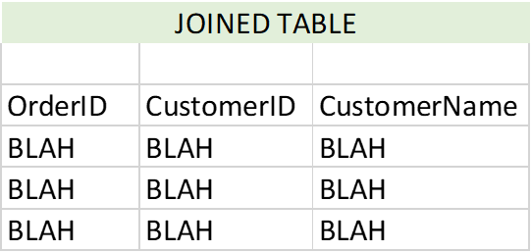
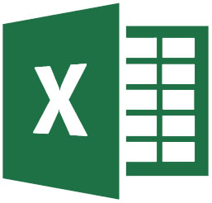
What is a JOIN?
LEFT/PRIMARY TABLE
RIGHT/SECONDARY TABLE
Same thing as a VLOOKUP in Excel
Notes:
But let's take a step back. Why should I even be watching this video? Why should I even be learning this stuff? Well learning SQL enables you to do a number of things. 1. As a consultant, you'll be able to effectively communicate with other business analysts. You'll be able to speak to them in their own language. You'll also be able to tell a client that you have a great analytics foundation. And ultimately, with your new skills in SQL, you'll be able to eliminate the analytics bottleneck. What is the analytics bottleneck? Well that segues nicely into our next slide, where does SQL fit in the data flow?

Slide 53
What is required to join tables in SQL?
At least 2 tables, with at least 1 column/field in common
Column/field(s) tables have in common, MUST be same data type
The column/field in Table B should be unique, otherwise duplication will occur (more on this later)
Notes:
But let's take a step back. Why should I even be watching this video? Why should I even be learning this stuff? Well learning SQL enables you to do a number of things. 1. As a consultant, you'll be able to effectively communicate with other business analysts. You'll be able to speak to them in their own language. You'll also be able to tell a client that you have a great analytics foundation. And ultimately, with your new skills in SQL, you'll be able to eliminate the analytics bottleneck. What is the analytics bottleneck? Well that segues nicely into our next slide, where does SQL fit in the data flow?

Slide 54
What is the JOIN syntax?
SELECT
A.ORDERID
,A.CUSTOMERID
,B.CUSTOMERNAME
FROM
ORDERS A
JOIN CUSTOMERS B
ON B.CUSTOMERID = A.CUSTOMERID
GROUP BY
A.ORDERID
,A.CUSTOMERID
,B.CUSTOMERNAME
1.ASSIGN AN ALIAS to each table and apply it to each distinct column.
2. JOIN ON the columns the TWO tables have in common (make sure same data type)
3. You need indicate what STYLE of JOIN (more than 1 style)
Notes:
But let's take a step back. Why should I even be watching this video? Why should I even be learning this stuff? Well learning SQL enables you to do a number of things. 1. As a consultant, you'll be able to effectively communicate with other business analysts. You'll be able to speak to them in their own language. You'll also be able to tell a client that you have a great analytics foundation. And ultimately, with your new skills in SQL, you'll be able to eliminate the analytics bottleneck. What is the analytics bottleneck? Well that segues nicely into our next slide, where does SQL fit in the data flow?

Slide 55
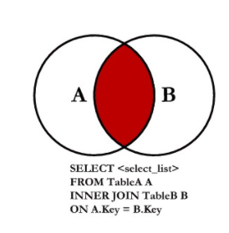
How do we visualize an INNER JOIN?
ORDERS
CUSTOMERS
NULL
4
1
2
8
3
JOIN → EVERYTHING TABLE A and B HAVE IN COMMON
Notes:
What are the drawbacks to this kind of join?

Slide 56
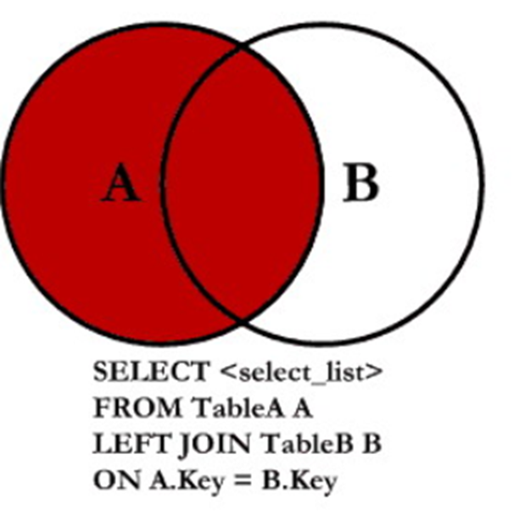
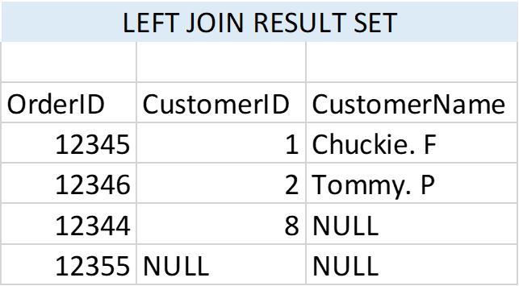
How do we visualize a LEFT JOIN?
ORDERS
CUSTOMERS
NULL
4
1
2
8
3
LEFT JOIN → EVERYTHING THAT’s in Table A regardless of whether it’s in Table B
Notes:
What are the drawbacks to this kind of join?

Slide 57

What are the other types of JOINs?
Notes:
What are the drawbacks to this kind of join?

Slide 58

Group Activity: Which JOIN do I use? (20 min)
Question: What is the count of customers and orders by state?
GROUP 1
Step 1: Make a joined table of order_id, cust_id, and state. Draw circles to help you.
Step 2: Make a table of the count of orders and customers in each state. Remember, don’t count NULL customer or order IDS.
Step 3: Tell us the total order and customer count overall.
GROUP 2
GROUP 3
GROUP 4
GROUP 5
Notes:
What are the drawbacks to this kind of join?

Slide 59
Which JOIN do I use? (Most Common Use Cases)
“Give me a list of total orders/customers by customer’s state.”.
INNER JOIN
LEFT JOIN
FULL OUTER JOIN
GROUP 1
GROUP 2
WILL EXCLUDE ALL ORDERS FOR CUSTOMERS THAT AREN’T IN TABLE B
Consequence: Order count underreported
WILL INCLUDE ORDERS FOR ALL CUSTOMERS, REGARDLESS OF EXISTENCE IN TABLE B.
Consequence: Some orders won’t have a state assigned to them (will appear as NULL for State)
WILL INCLUDE ALL ORDERS AND CUSTOMERS FROM BOTH TABLES
Consequence: Some order’s won’t have a state assigned to them, and some customer’s won’t have an order assigned to them.
Notes:
What are the drawbacks to this kind of join?

Slide 60
Which JOIN do I use? (Fringe Use Cases)
“Give me a list of total orders/customers by customer’s state.”
LEFT JOIN, WHERE CUST_ID IS NULL in TABLE B
FULL OUTER JOIN, WHERE CUST_ID IS NULL in TABLE A and B
USE CASE: You only want to see orders for customers that aren’t in Table B.
Tell DBA to update Customer Attributes; Table B
USE CASE: You only want to see orders from customers that don’t exist in Table B
AND
You only want to see customers that don’t exist in Table A (don’t have an order)
Notes:
What are the drawbacks to this kind of join?

Slide 61
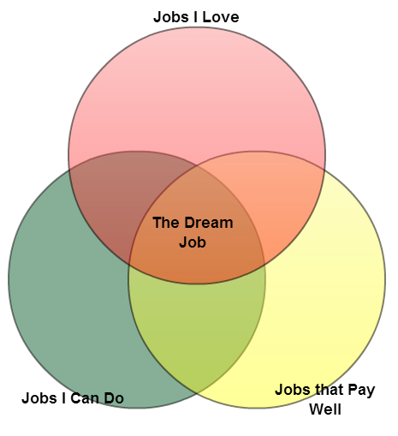
Can you join to more than 1 table?
SELECT c.field, a.field, b.field, a.field,c.field
FROM table1 a
JOIN table2 b
ON a.field=b.field
JOIN table3 c
ON a.field=c.field
Notes:
What are the drawbacks to this kind of join?

Slide 62
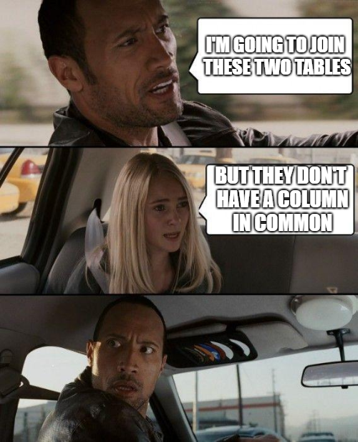
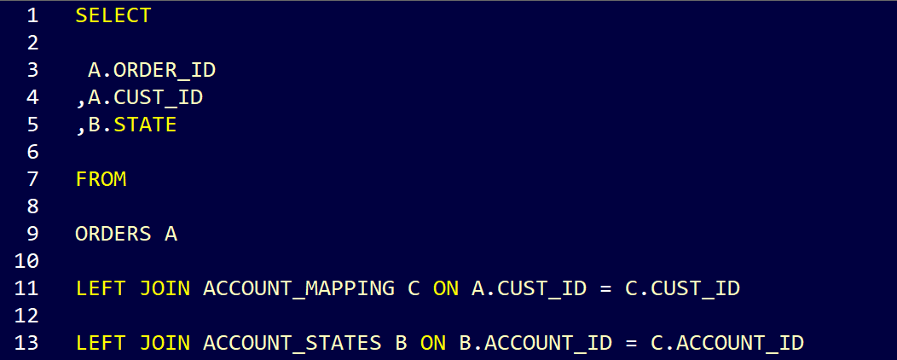
What if you want to join two tables that don’t share the same column?
When you want to join two tables but they don’t have a column in common to JOIN two tables, but they don’t have a column in common
SOLUTION: DAISY CHAINING
Notes:
What are the drawbacks to this kind of join?

Slide 63

What if you are getting duplicate records or rows after performing a join?
Joining on CUST_ID
CUST_ID is not unique in Table B
REQUIREMENTS FOR A JOIN BETWEEN TWO TABLES
At least 2 tables, with at least 1 column/field in common
Column/field(s) tables have in common, MUST be same data type
The column/field in Table B should be unique, otherwise duplication will occur (more on this later)
SOLUTIONS
Dedup TABLE B via Subquery or CTE.
Join on more than column, if possible.
Notes:
What are the drawbacks to this kind of join?

Slide 64
Instructor Led: Write the SQL JOIN as a Class
Framework for approach
Draw the result-output first. Determine if you need a join or not.
Make sure 3 JOIN requirements are met.
Follow 3 rules of the JOIN syntax.
Pick appropriate JOIN. Be ready to defend.
Hey Analyst, Give me the top 10 stores in terms of sales for 2014. I want them listed by store name.
Notes:
But let's take a step back. Why should I even be watching this video? Why should I even be learning this stuff? Well learning SQL enables you to do a number of things. 1. As a consultant, you'll be able to effectively communicate with other business analysts. You'll be able to speak to them in their own language. You'll also be able to tell a client that you have a great analytics foundation. And ultimately, with your new skills in SQL, you'll be able to eliminate the analytics bottleneck. What is the analytics bottleneck? Well that segues nicely into our next slide, where does SQL fit in the data flow?

Slide 65
JOINING Tables: Key Takeaways
If you want to join two tables, they must have 1 column in common, and of the same data type. The rows/records in Table B should be unique, otherwise duplication. Check TABLE B with supplied code.
The JOIN style will determine the result-output. Think about what records/rows will be excluded. Left joins are safest.
Work backwards, draw result output first, then determine ingredients to writing code.
Notes:
But let's take a step back. Why should I even be watching this video? Why should I even be learning this stuff? Well learning SQL enables you to do a number of things. 1. As a consultant, you'll be able to effectively communicate with other business analysts. You'll be able to speak to them in their own language. You'll also be able to tell a client that you have a great analytics foundation. And ultimately, with your new skills in SQL, you'll be able to eliminate the analytics bottleneck. What is the analytics bottleneck? Well that segues nicely into our next slide, where does SQL fit in the data flow?

Slide 66
Part 9 ADVANCED SQL TOPICS
Notes:
But let's take a step back. Why should I even be watching this video? Why should I even be learning this stuff? Well learning SQL enables you to do a number of things. 1. As a consultant, you'll be able to effectively communicate with other business analysts. You'll be able to speak to them in their own language. You'll also be able to tell a client that you have a great analytics foundation. And ultimately, with your new skills in SQL, you'll be able to eliminate the analytics bottleneck. What is the analytics bottleneck? Well that segues nicely into our next slide, where does SQL fit in the data flow?

Slide 67
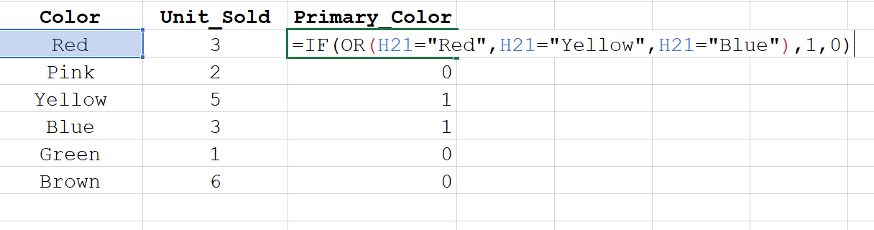
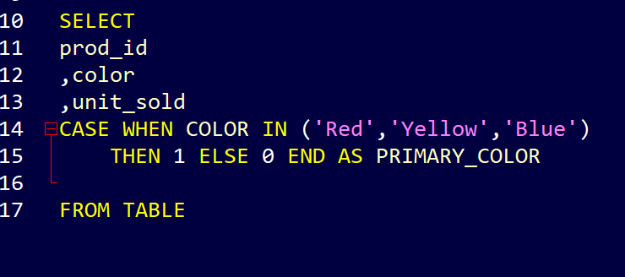
Writing Conditional Statements in SQL (CASE)
Question: Give me total sales for primary color items vs. non-primary color items…
IF Statement
CASE Statement
Notes:
What are the drawbacks to this kind of join?

Slide 68
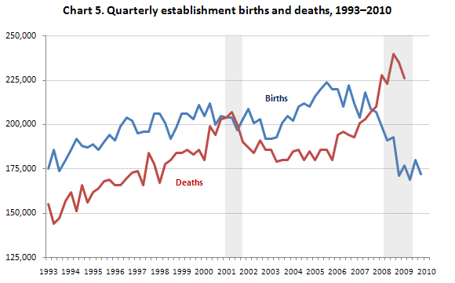
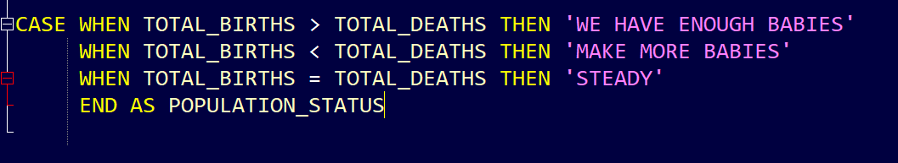
CASE Statement Use Cases
Case statements are useful for
Categorization
Inspiring action
Notes:
What are the drawbacks to this kind of join?

Slide 69
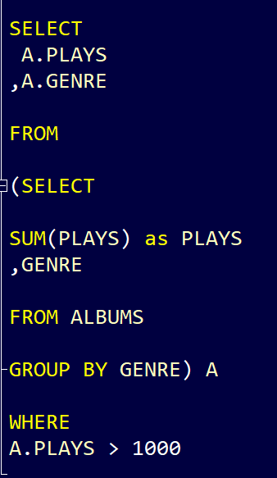
Writing Subqueries in SQL – Use Cases
What is a subquery?
It’s a tool for performing operations in multiple steps. It’s a query within a query. Use to return data that will be used in the main query.
When would you use?
You want to take an aggregate of an aggregate
You want to de-duplicate a table to perform a JOIN
You want reference information from multiple tables
You want to use WHERE to filter on an aggregate
What is the order of operations for a subquery?
From inside out (Subquery runs first → Main query runs second))
What are the requirements?
Subqueries must be enclosed in ()
An alias must be supplied to them
RUNS 2nd
RUNS 1st
Notes:
What are the drawbacks to this kind of join?

Slide 70
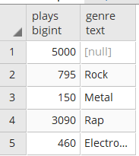
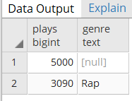
Writing Subqueries in SQL – Example Flow
RUNS 1st – Creation of Table A
RUNS 2nd
RUNS 1st
RUNS 2nd – Run SELECT STATEMENT, off Table A
Notes:
What are the drawbacks to this kind of join?

Slide 71
Part 10 CONCLUSION
Notes:
But let's take a step back. Why should I even be watching this video? Why should I even be learning this stuff? Well learning SQL enables you to do a number of things. 1. As a consultant, you'll be able to effectively communicate with other business analysts. You'll be able to speak to them in their own language. You'll also be able to tell a client that you have a great analytics foundation. And ultimately, with your new skills in SQL, you'll be able to eliminate the analytics bottleneck. What is the analytics bottleneck? Well that segues nicely into our next slide, where does SQL fit in the data flow?

Slide 72
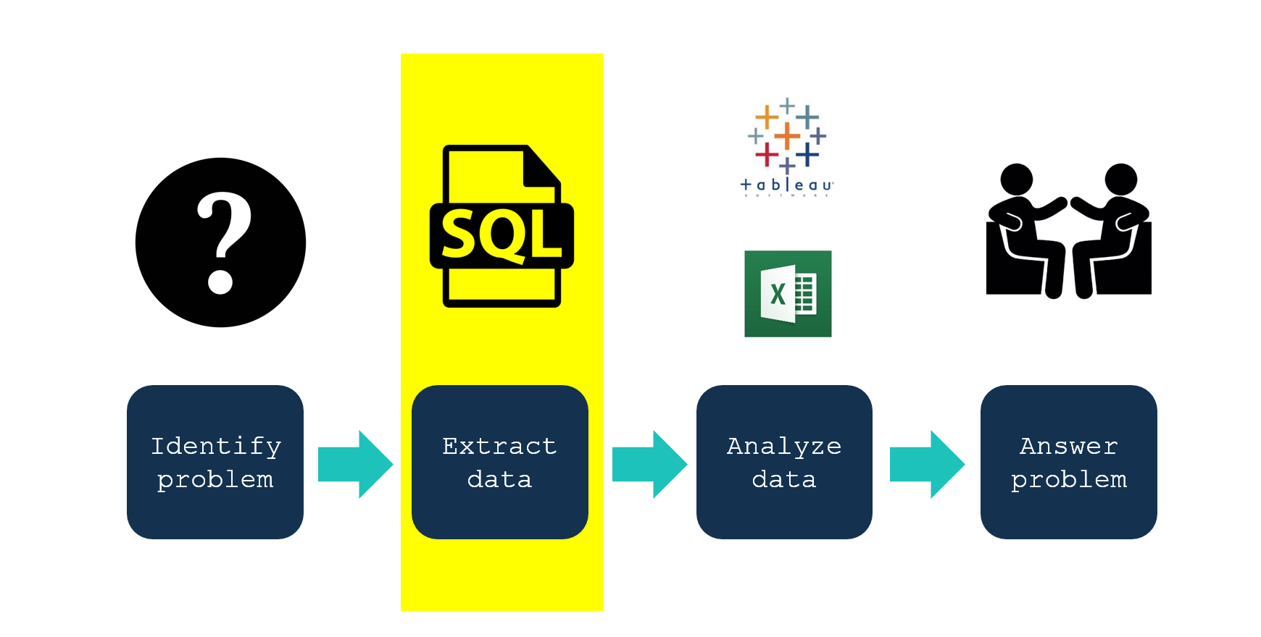
We extracted the data, using SQL. Now what do we do with it?
Remember, the analytics workflow!
Notes:
What are the drawbacks to this kind of join?

Slide 73
Conclusion: Key Takeaways
The more you talk to a database, you more comfortable you’ll get.
Today’s class gave us a framework for not just talking to ‘Red’, but to any relational database.
3. Don’t let anyone stop you from getting to know a database; push hard.
Notes:
But let's take a step back. Why should I even be watching this video? Why should I even be learning this stuff? Well learning SQL enables you to do a number of things. 1. As a consultant, you'll be able to effectively communicate with other business analysts. You'll be able to speak to them in their own language. You'll also be able to tell a client that you have a great analytics foundation. And ultimately, with your new skills in SQL, you'll be able to eliminate the analytics bottleneck. What is the analytics bottleneck? Well that segues nicely into our next slide, where does SQL fit in the data flow?

Slide 74
Example Email to Send To Your DBA to Get Access
Hello DBA,
I’d to request SELECT access to our relational database that stores (x) data. Could you supply me the necessary credentials or Wiki for gaining access?
Could you also let me know
Which version of SQL our organization uses? (E.g. Oracle / MySQL / Hive / PostgreSQL / IBM BIG Insights / SQL Server / etc.)
What RDBMS (or GUI) we use as a query tool?
Any information regarding the schema structure of the tables in the database for reference.
Thanks,
Your Name
Notes:
Hope you folks enjoyed your conversation with both me and Red today. And let us know…if you have any question’s you’d like answered.

Slide 75
Q&A (15 min)
Notes:
Hope you folks enjoyed your conversation with both me and Red today. And let us know…if you have any question’s you’d like answered.

